Slide 1
COURSE RECOMMENDATIONS WITH MACHINE LEARNING
Cataldo Cocuzza
Adrian Dayrit
Kefan Liao
Fay Muhammad
Robert Rose
Christopher Scarlata

Slide 2
AGENDA
Project Overview
About the Dataset
Machine Learning Tools
Data Model Prep and Optimization
DEMO
Limitations & Future Development
Ethical Considerations

Slide 3
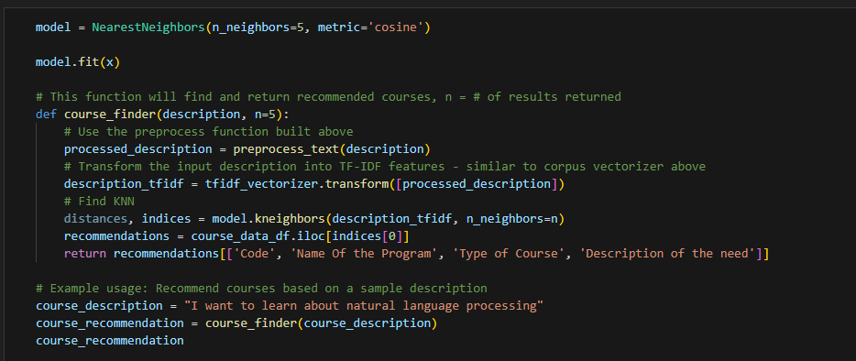
PROJECT OVERVIEW
Notes:
We used natural language processing (NLP) to build a machine learning program that identifies and recommends relevant courses based on the user’s input.

Slide 4
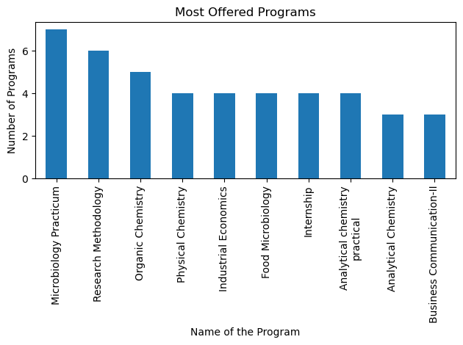
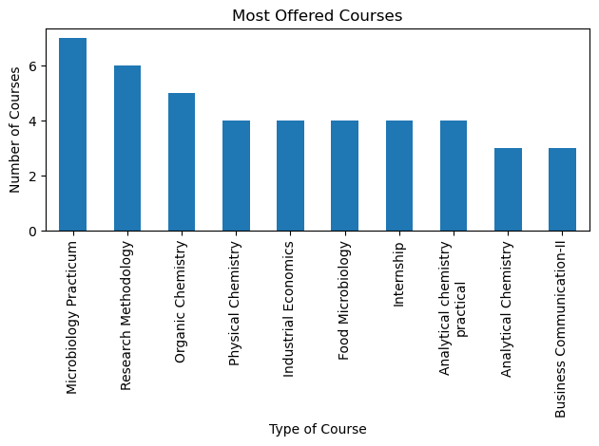
ABOUT THE DATASET
Source: Course Relevance Dataset from Kaggle*
Total Data Points: n = 905
Data Attributes | Description | Data Type
SrNo | Serial Number | Integer
Name Of the Program | Graduation or Post Graduation Program | String
Type of Course | Subject Name within selected program | String
Code | Subject Code | String
Need | Type of Developmental Need the subject is catering to | String
Description of the need | Description of Developmental Need associated to the subject | String
*Link: https://www.kaggle.com/datasets/prasad22/course-relevance-dataset

Slide 5
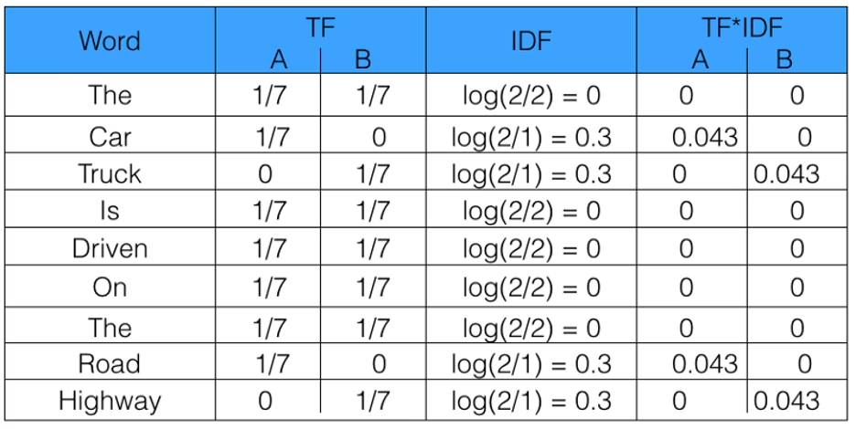
MACHINE LEARNING TOOLS
A = “The car is driven on the road”
B = “The truck is driven on the highway”
Libraries and Key Packages
PySpark
Matplotlib
Pandas
NLTK
Tokenizer
Lemmatizer
Stop words
Sklearn
TF-IDF
Nearest Neighbor
Image from freeCodeCamp - How to process textual data using TF-IDF in Python (https://www.freecodecamp.org/news/how-to-process-textual-data-using-tf-idf-in-python-cd2bbc0a94a3/)

Slide 6
DATA MODEL PREP & OPTIMIZATION
Lemmatizer:
Lemmatization is the pre - process involved in natural language processing, which involves distilling words to their foundational forms.
We used WordNetLemmatizer() to convert the robust description to their basic word forms.
TF-IDF:
Term Frequency (TF) – Measures how often a word appears in a document, with more frequent words getting higher scores.
Inverse Document Frequency (IDF) – Highlights unique words by lowering the score of common words.
TF-IDF essentially combines TF and IDF to give a balanced score. It’s a technique to quantify important or rare words that appear frequently in documents
We used TfidfVectorizer() to convert the text data into numerical vectors.

Slide 7
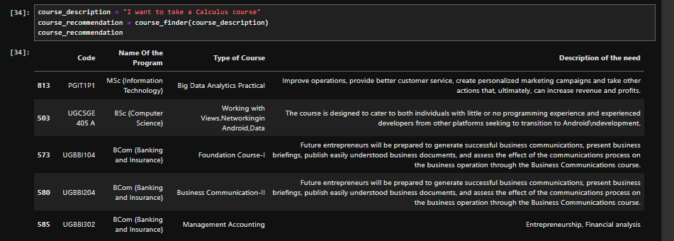
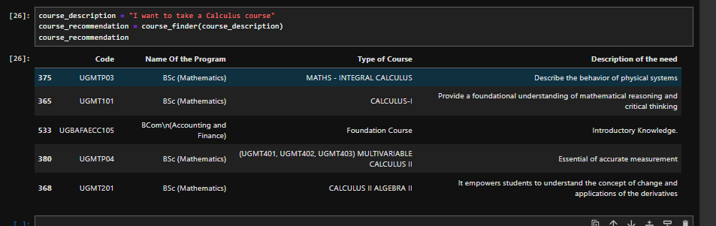

Slide 8
DEMO – DATA MODEL OPTIMIZATION

Slide 9
LIMITATIONS &
FUTURE DEVELOPMENT
Limitations
Based on the data fed i.e course description into the model, it will pick up results that might not necessarily relate to the course you’re looking for as a whole.
Example: “Natural Language Processing” will result in courses that might relate to gardening or nature
Future Development
In the future, the code should adapt to new data or user interactions over time to make the results more accurate to the course that the user is looking for.
Integrate code that makes the program continuously ask for user input to improve recommendations automatically without having to hard-code results.
Build a user-friendly interface for inputting searches and viewing recommendations using Flask
Part of speech could be incorporated in the Lemmatizer, providing more accuracy to Lemmatized words.

Slide 10
ETHICAL CONSIDERATIONS
Bias and Fairness
Privacy and Consent
Misuse and Manipulation

Slide 11
THANK YOU

